Slide 1
PERINEUM
BY: M. G. HAMMAD

Slide 2
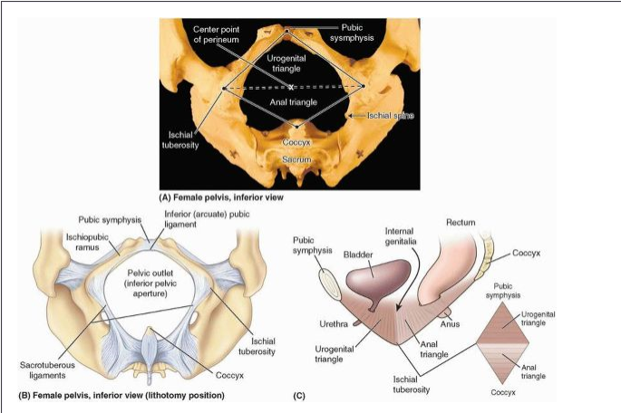
PERINEUM
Part of the trunk of the body caudal to the pelvic diaphragm (levator ani and coccygeus).
It is a diamond-shaped area.
It divided by line joining ischial tuberosities into:
Large posterior area: Anal region.
Small anterior area: Urogenital region.

Slide 3
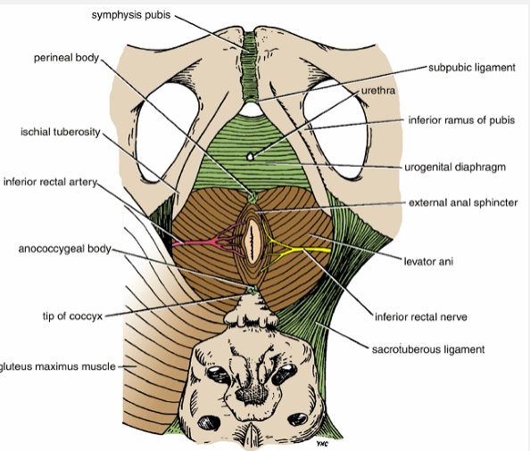
ANAL REGION {TRIANGLE}
Boundaries:
Sides: by
Sacrotuberous ligament.
Lower edge of GM.
Contents:
Anal canal.
Ischioanal fossa & its contents.

Slide 4
UROGENITAL REGION {TRIANGLE}
The region lies in front of the line joining the anterior parts of the ischial tuberosities.
Boundaries:
Laterally: by the conjoined ischiopubic rami.
Posteriorly: line joins ischial tuberosities.

Slide 5
UROGENITAL REGION {TRIANGLE}
Contents:
External genitalia.
Muscles.
Fascia.
Pouches.

Slide 6
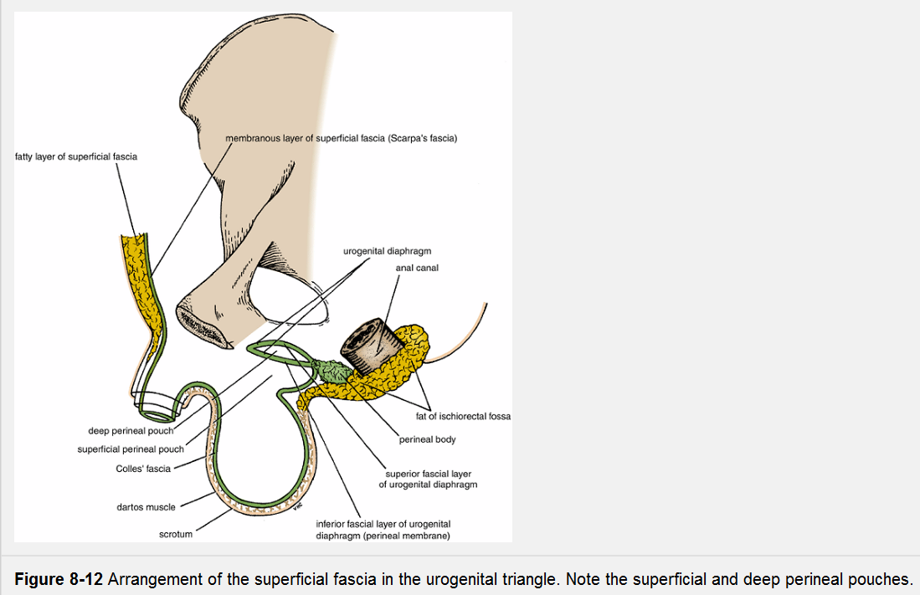
FASCIAE AND POUCHES OF UROGENITAL TRIANGLE
PERINEAL FASCIAE:
Consist of:
Superficial P fascia.
Deep P fascia.
The subcutaneous tissue of the perineum:
Consists of superficial fatty layer and deep membranous layer {superficial perineal fascia or Colle's fascia}.

Slide 7
FASCIAE AND POUCHES OF UROGENITAL TRIANGLE
Fatty layer of perineal subcutaneous tissue:
In Female:
The fatty layer makes up substance of labia majora and mons pubis.
It continuous anteriorly and superiorly with the fatty layer of abdomen (Camper fascia).
In Male:
Replaced in the penis and scrotum with smooth (dartos) muscle.
In both sexes: it continuous posteriorly with the Ischioanal fat pad in the anal region.

Slide 8
FASCIAE AND POUCHES OF UROGENITAL TRIANGLE
Membranous layer of perineal subcutaneous tissue:
In Female: does not extend into the anal triangle.
It forms SUPERFICIAL PERINEAL FASCIA.
Laterally: it is attached to the fascia lata.
Superiorly: passes to the fatty layer forming the labia majora and becomes continuous with the membranous layer of abdomen.
In Male:
It forms SUPERFICIAL PERINEAL FASCIA.
Anteriorly: continuous with the dartos fascia of the penis and scrotum.
On each side of and anterior to the scrotum: it becomes continuous with the membranous layer of abdomen (Scarpa fascia).

Slide 9
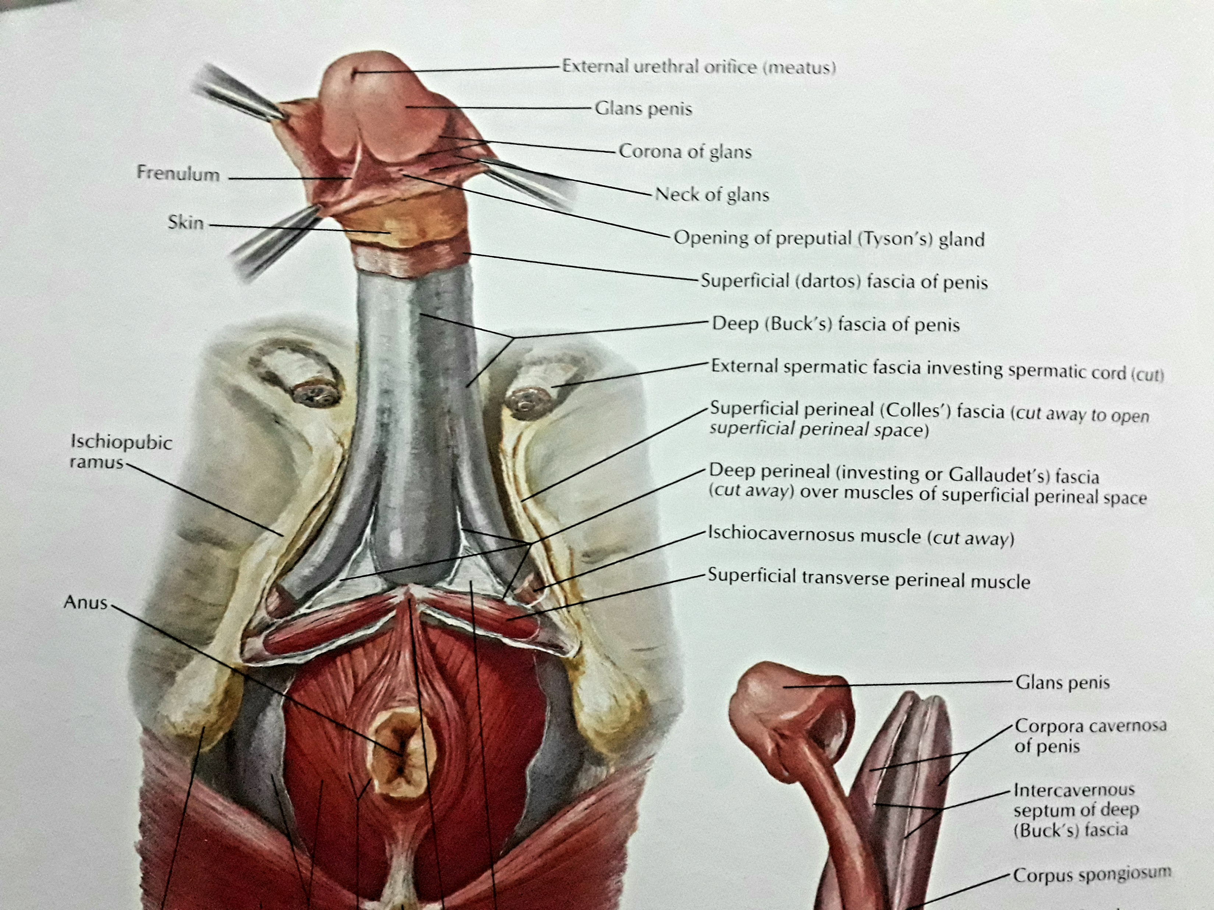
FASCIAE AND POUCHES OF UROGENITAL TRIANGLE
Deep perineal Fascia (investing or Gallaudet fascia):
invests the ischiocavernosus, bulbospongiosus, and superficial transverse perineal muscles.
Attached laterally to the ischiopubic rami.
In Female:
Fused with the suspensory ligament of the clitoris.
It continuous with the deep fascia covering the external oblique muscle and rectus sheath.
In Male:
Anteriorly: it is fused to the suspensory ligament of the penis.
It continuous with the deep fascia covering the external oblique muscle and rectus sheath.

Slide 10
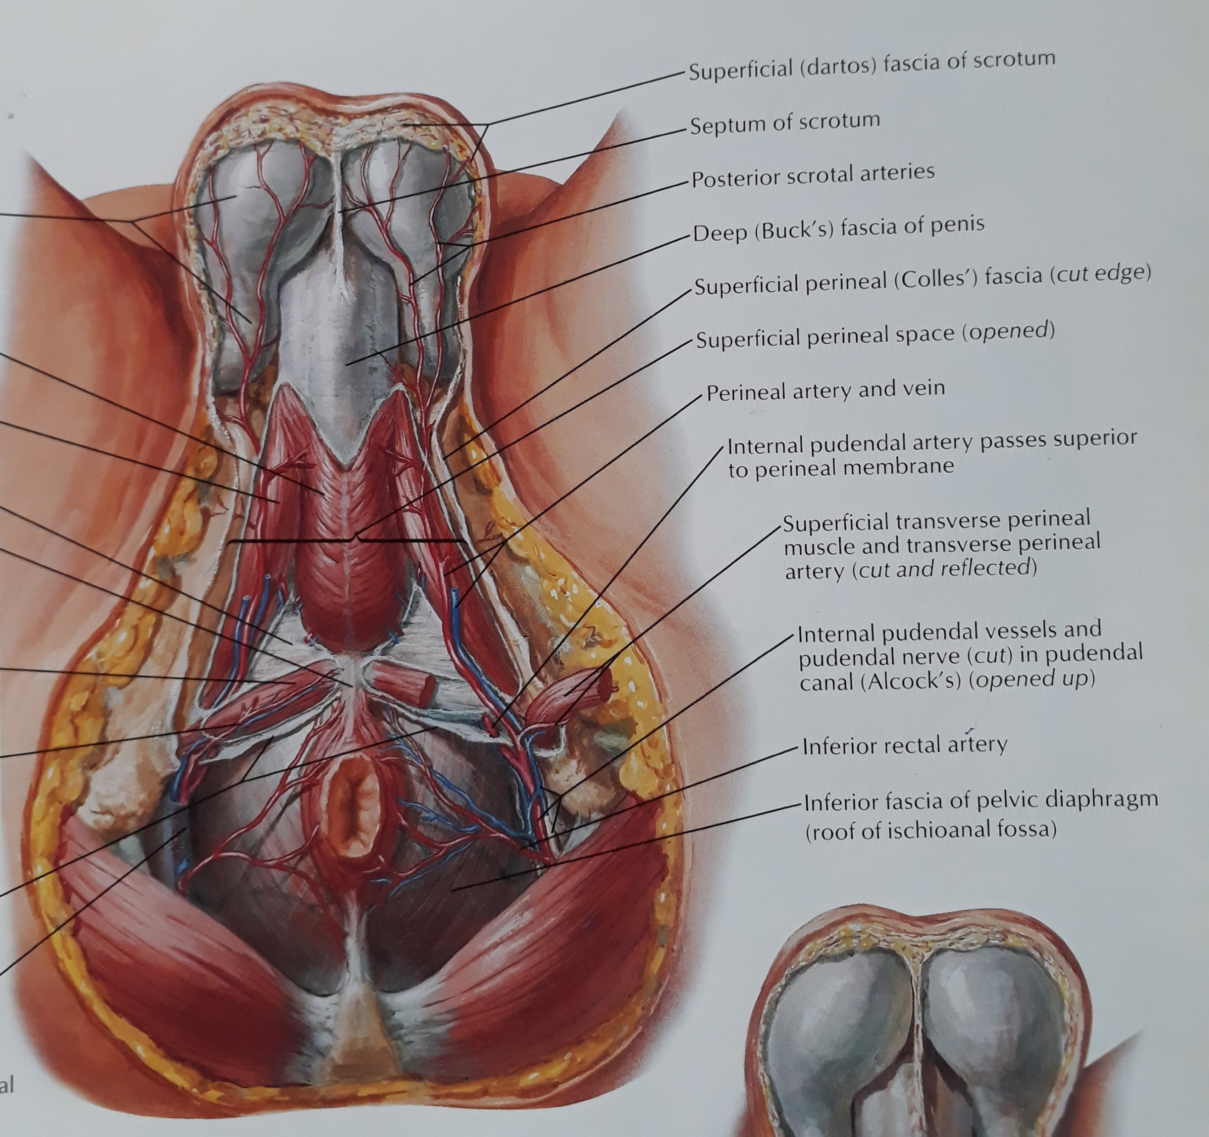
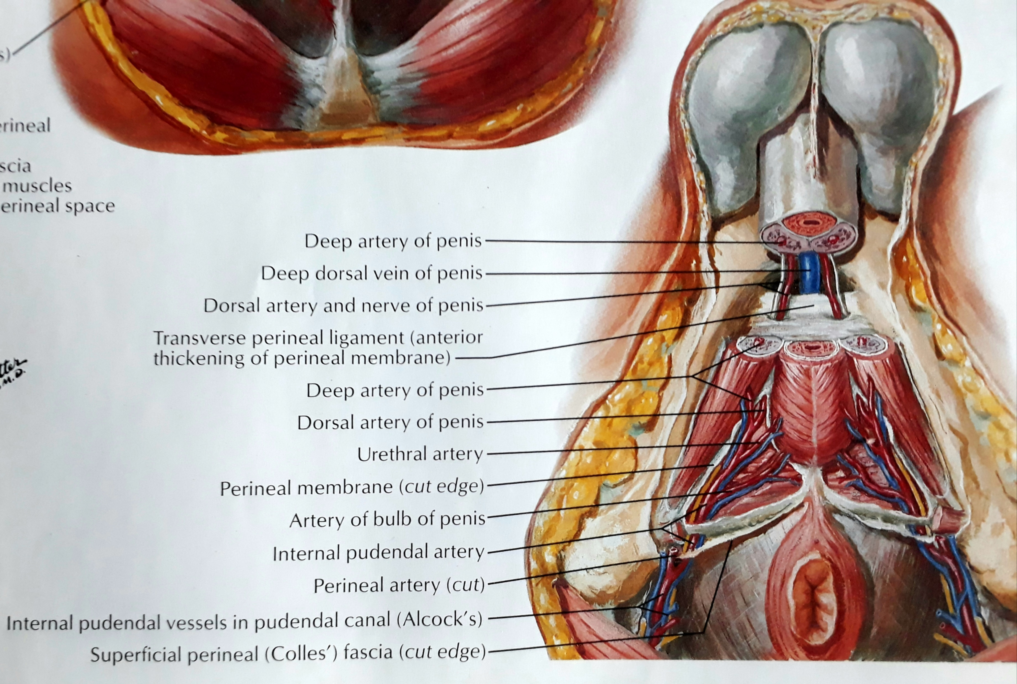
SUPERFICIAL PERINEAL POUCH
Potential space between the perineal fascia and the perineal membrane.
Bounded laterally by the ischiopubic rami.
Contents:
In Male:
Root (bulb and crura) of the penis and associated muscles (ischiocavernosus and bulbospongiosus).
Proximal (bulbous) part of the spongy urethra.
Superficial transverse perineal muscles.
Deep perineal branches of the internal pudendal vessels and pudendal nerves.

Slide 11
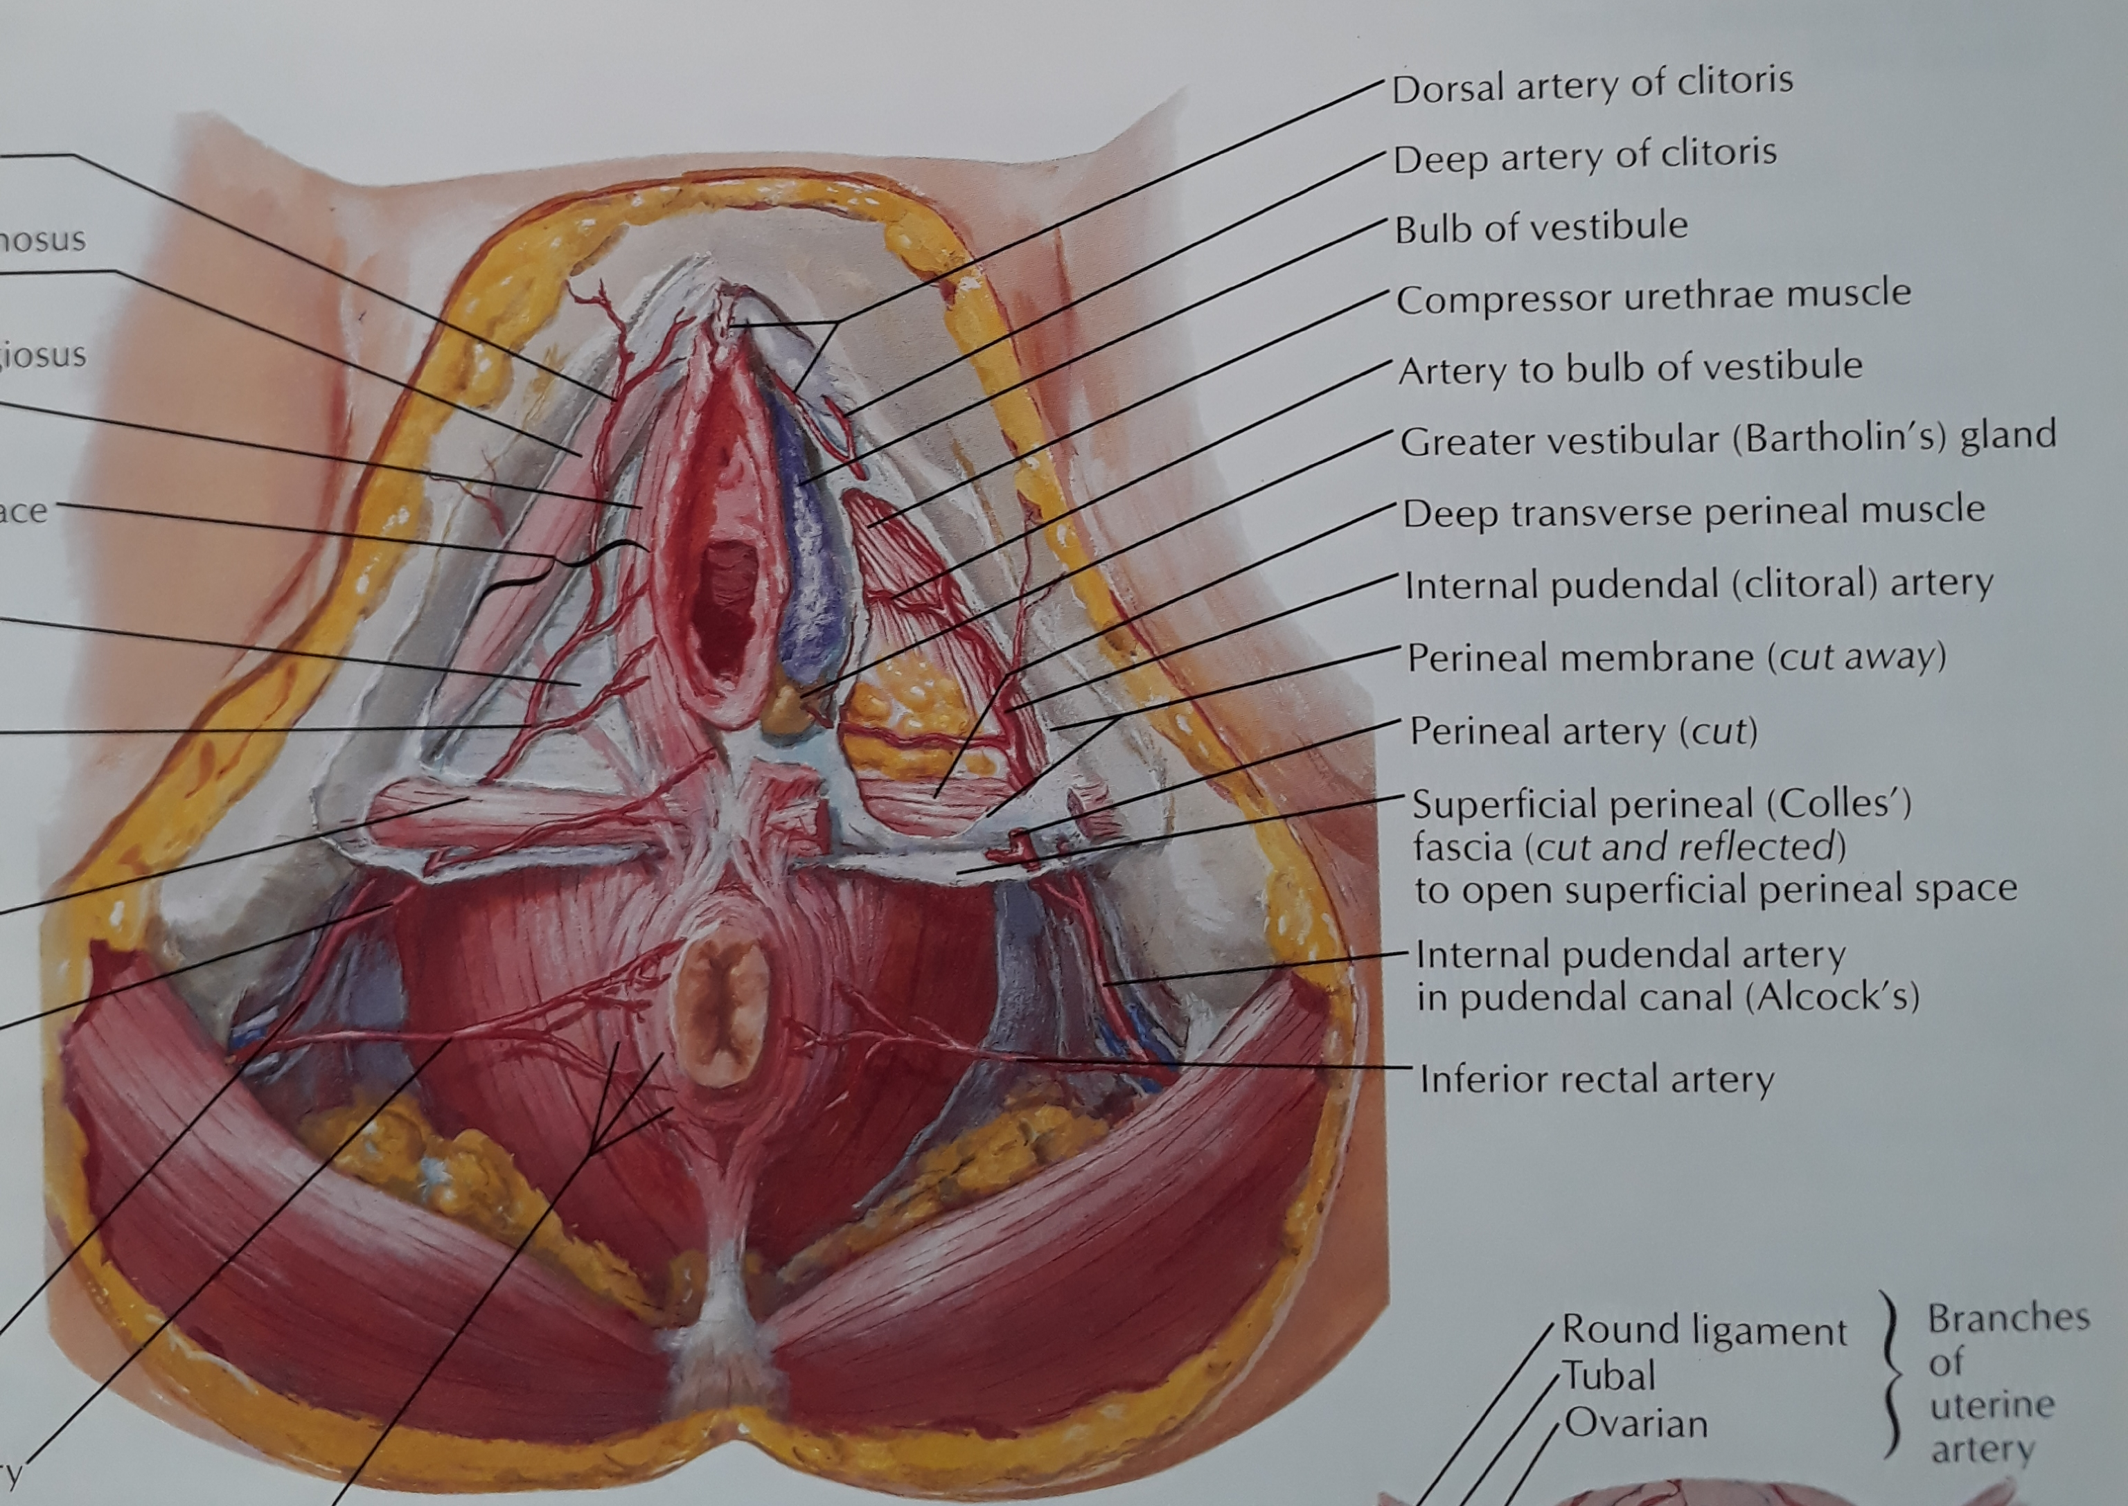
SUPERFICIAL PERINEAL POUCH
Contents:
In Female:
Clitoris and associated muscles (ischiocavernosus).
Bulbs of the vestibule and surrounding muscle (bulbospongiosus).
Greater vestibular glands.
Superficial transverse perineal muscles.
Related vessels and nerves (deep perineal branches of the internal pudendal vessels and pudendal nerves).

Slide 12
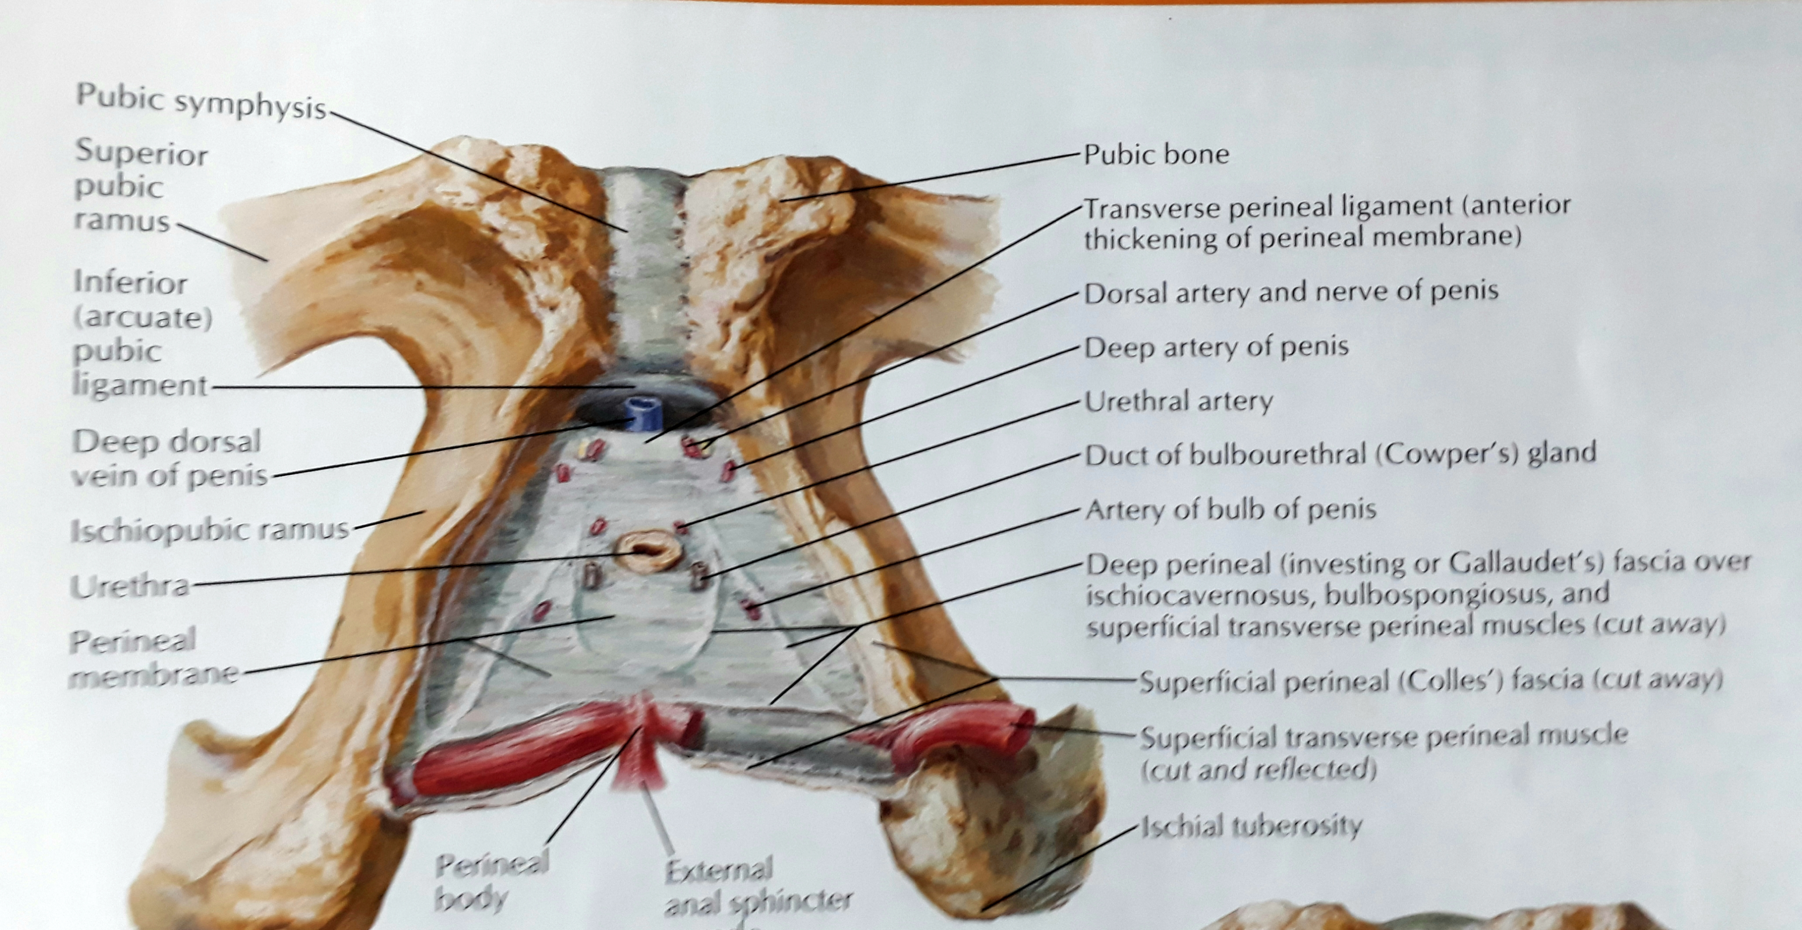
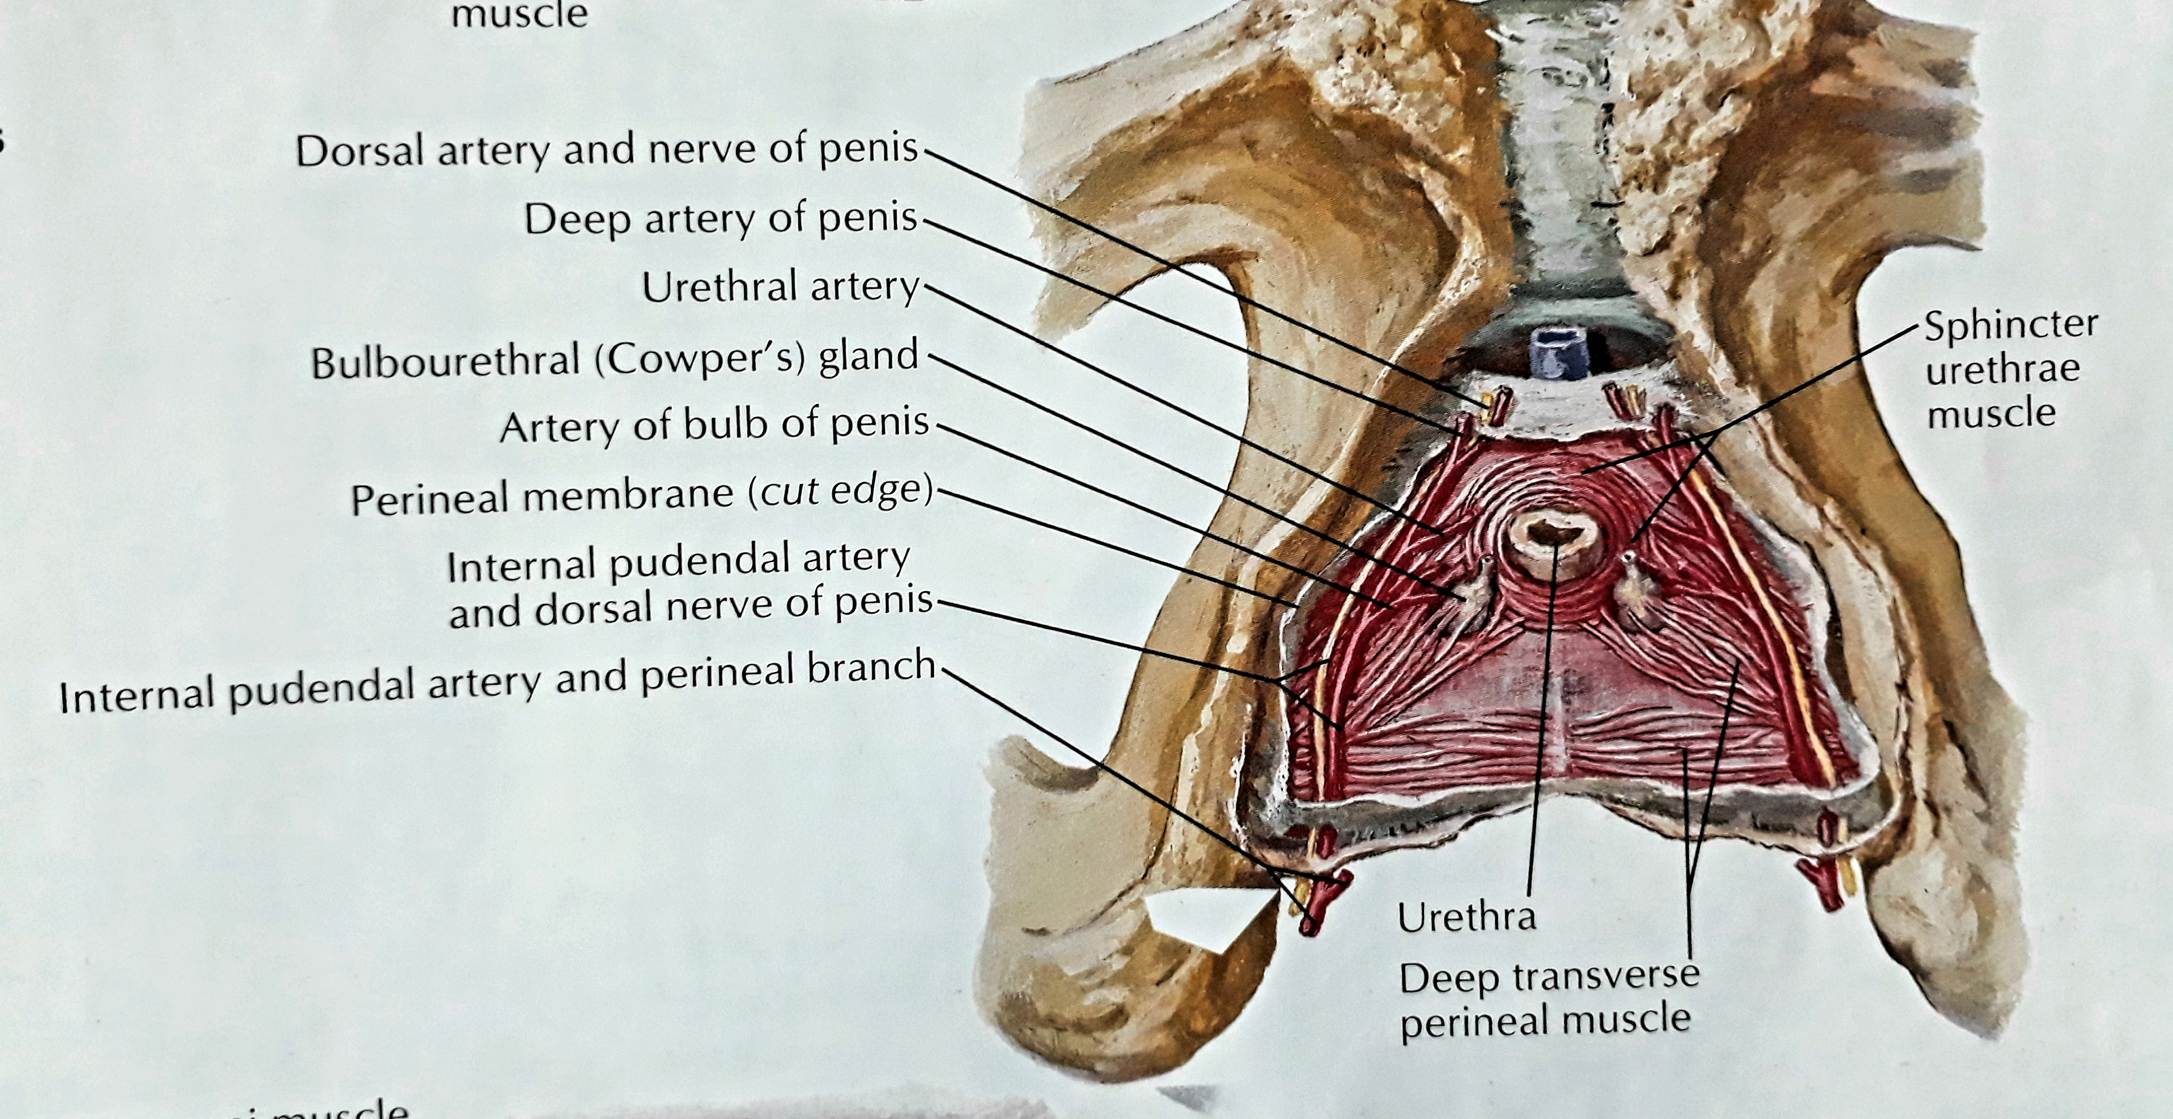
DEEP PERINEAL POUCH
Bounded inferiorly by the perineal membrane.
Superiorly by the inferior fascia of the pelvic diaphragm.
Laterally by the inferior portion of the obturator fascia.
Contents:
In both sex:
Part of the urethra.
The inferior part of the external urethral sphincter muscle.
Anterior extensions of the Ischioanal fat pads.

Slide 13
DEEP PERINEAL POUCH
Contents:
In Male:
Intermediate part of the urethra.
Deep transverse perineal muscles.
Bulbourethral glands.
Dorsal neurovascular structures of the penis.
In Female:
Proximal part of the urethra.
A mass of smooth tissues associated with the perineal body.
Dorsal neuro- vasculature of the clitoris.

Slide 14
THANKS

